Slide 1


MARCH 2023
Introduction to CAD
UQ MARS x MESS
Notes:
Ideal start at 6:05pm

Slide 2


Sign Up Here!
1
2

Slide 3







UQMARS Partners
UQ MESS Sponsors
Notes:
Introduction: slides 2-8 - 6:05 - 6:15pm

Slide 4
Agenda
What is CAD?
Design Process
Intro to NX
Introductory Project
Help

Slide 5
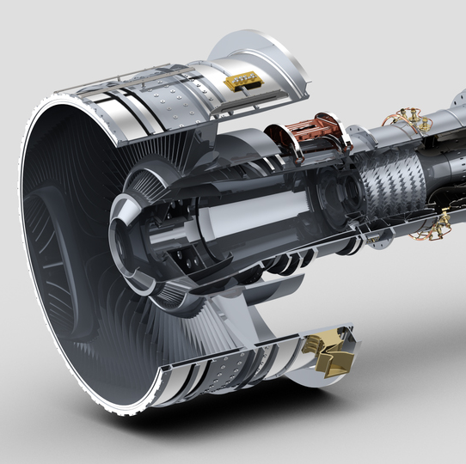
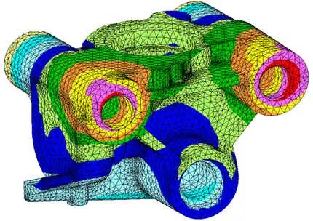
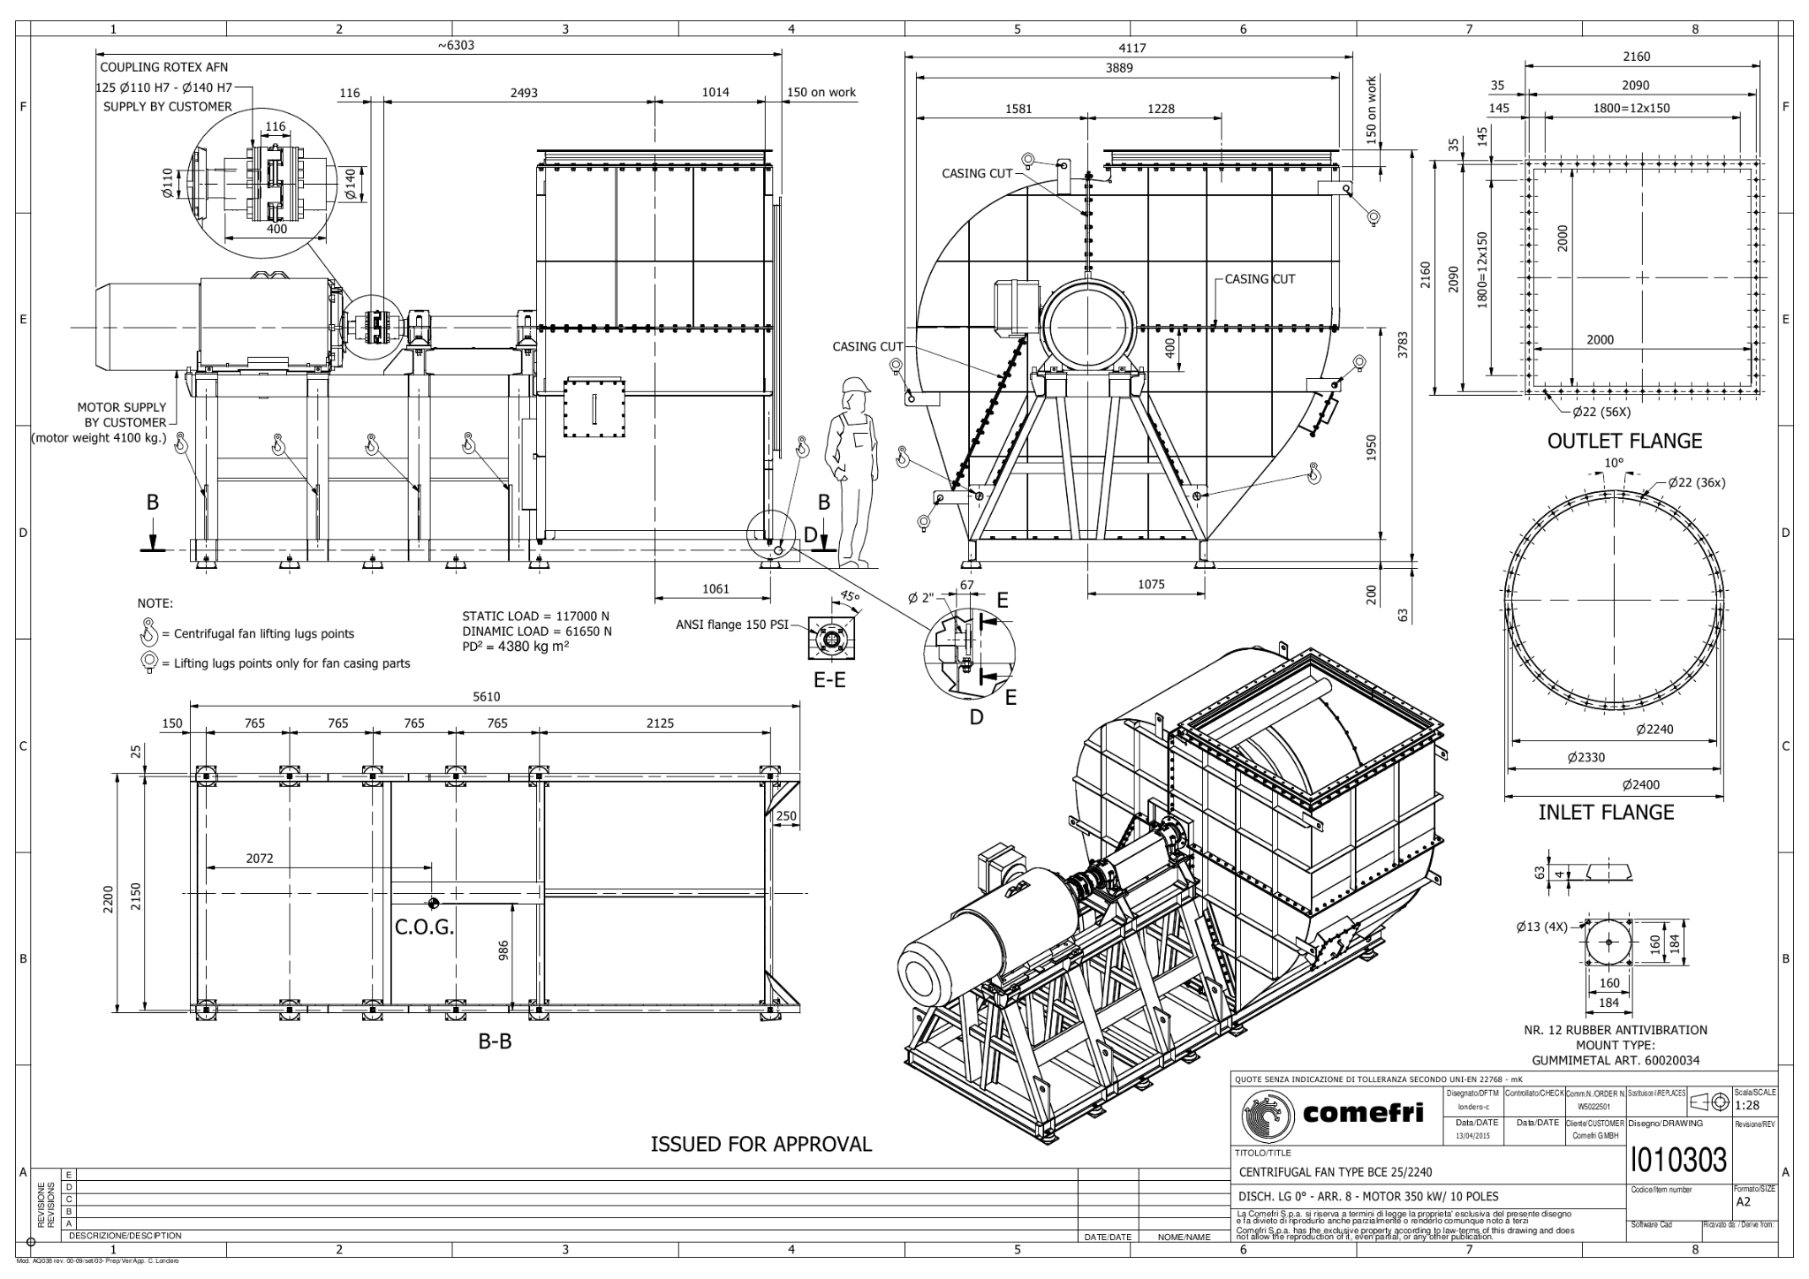
Computer Aided Design (CAD)
Creation
The use of computer software to aid in the design process.
CAD vs CADD vs BIM
Analysis & Optimisation
Communication

Slide 6
What for?
Assisted Design
Design new parts
3D Print and CNC
Required for 3D Printing etc.
Create Accurate Drawings
Model and analyse physical objects
Download ready-made parts

Slide 7
Getting Better at CAD
Understand the fundamentals
Tutorial videos & resources
Rapid Prototyping
Workshops!
Model and analyse physical objects
Keep using it!

Slide 8
CAD Design Process
Design individual parts
Combine parts into an assembly
Computer analysis
Present model as drawings

Slide 9







Software
We will be using NX
Alternatives are:
Autodesk Suite
Inventor
Solid Edge
SolidWorks
Blender*

Slide 10
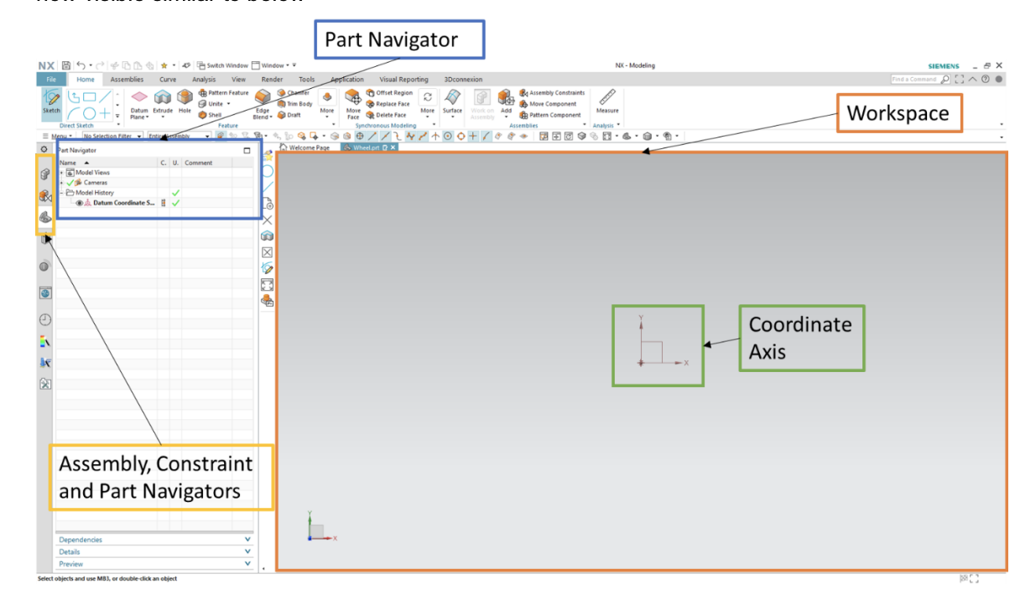
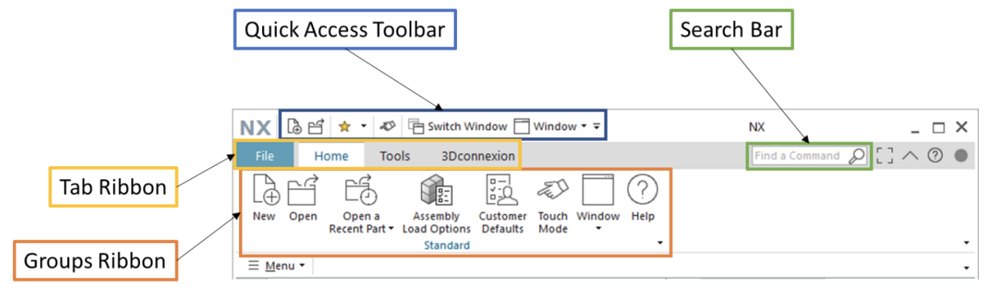
Getting Around NX
Navigating the UI
Structure of parts and assemblies
Notes:
6:15 - 6:20pm
You can reorientate the workspace by clicking and holding the middle mouse button while moving the mouse in the direction desired

Slide 11
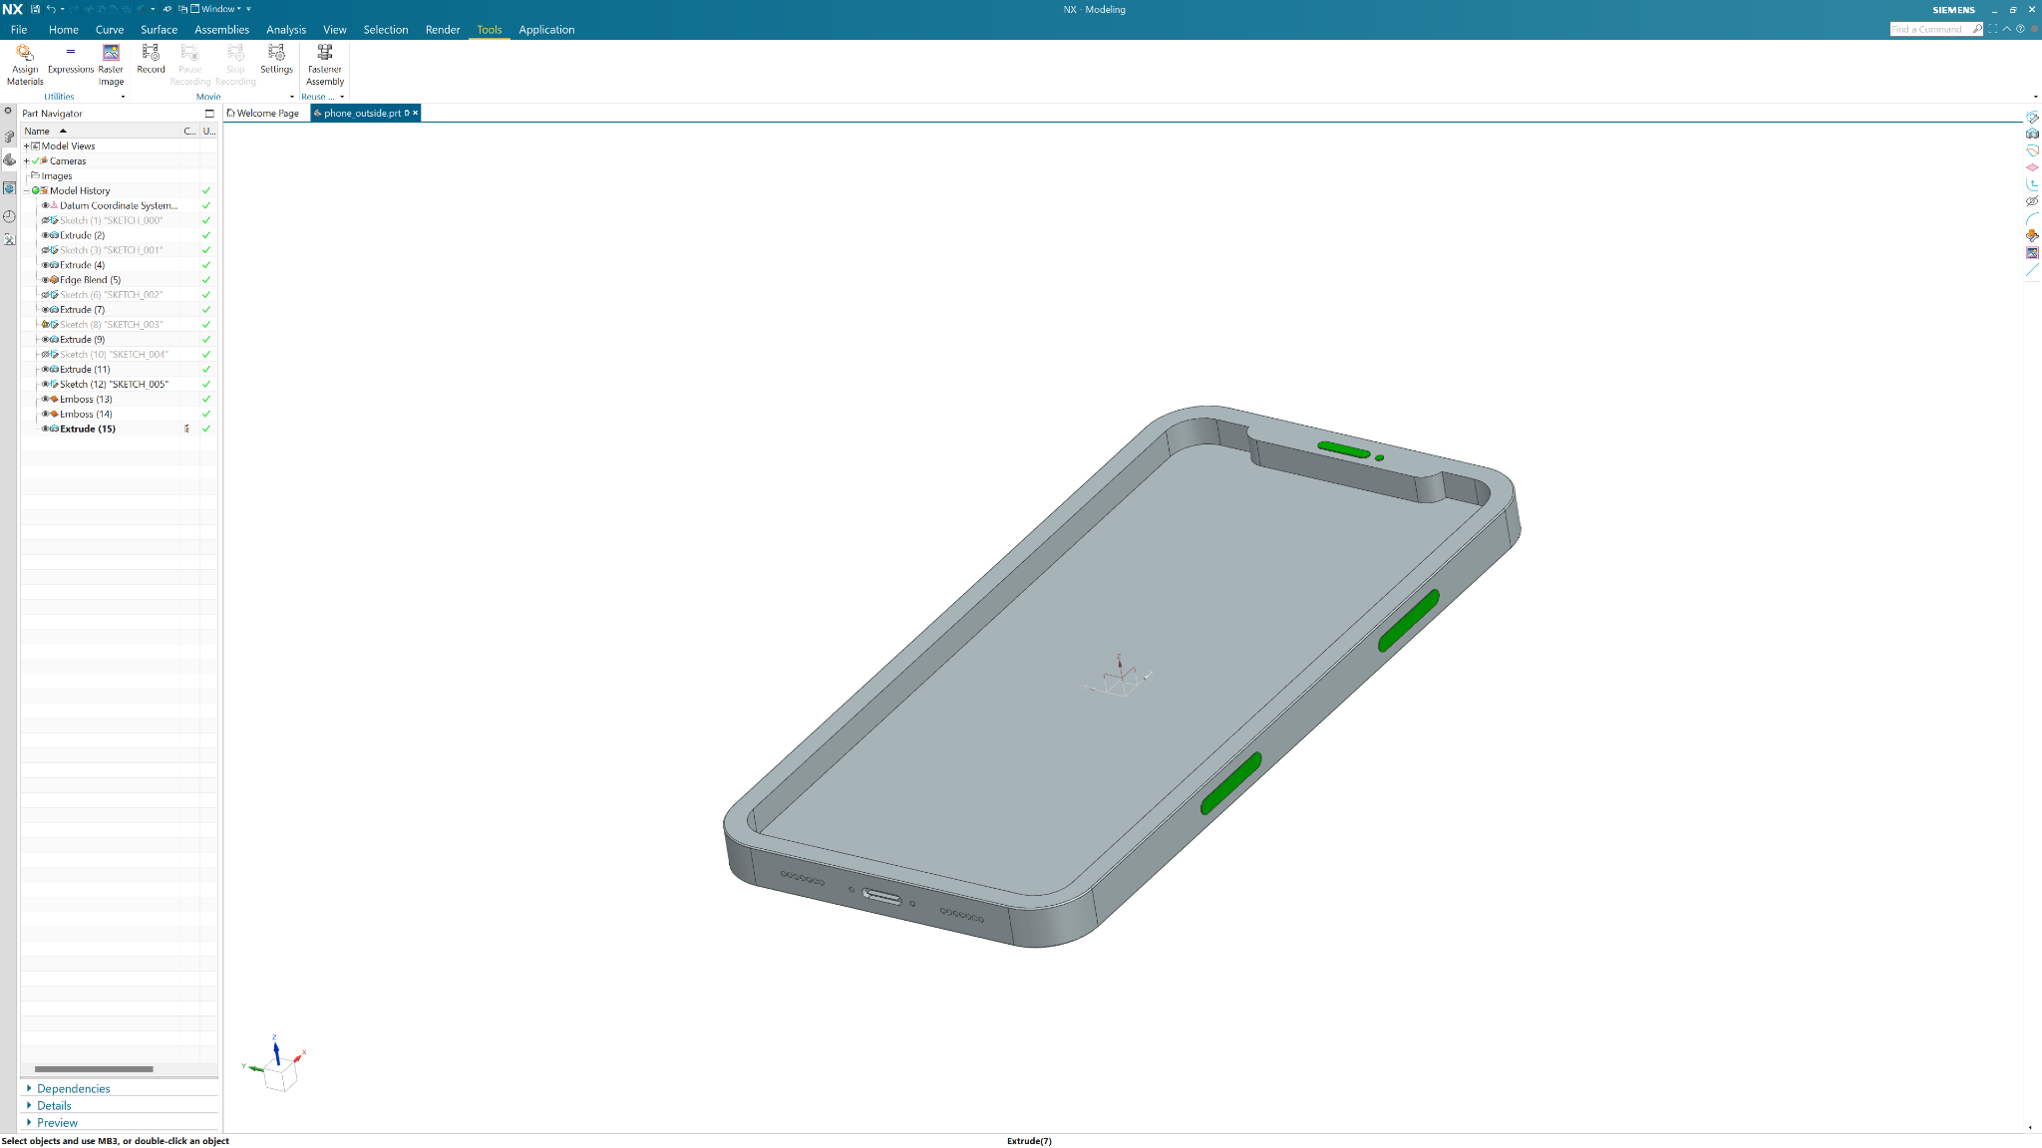
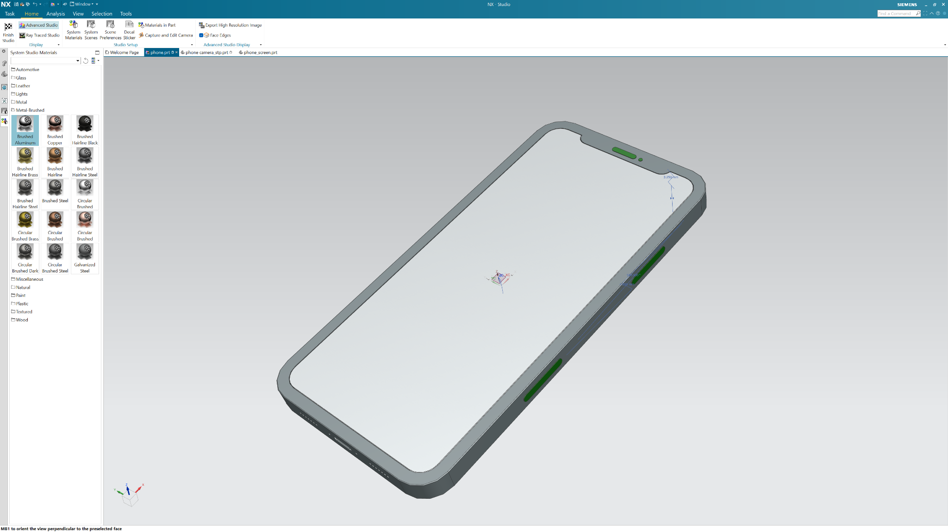
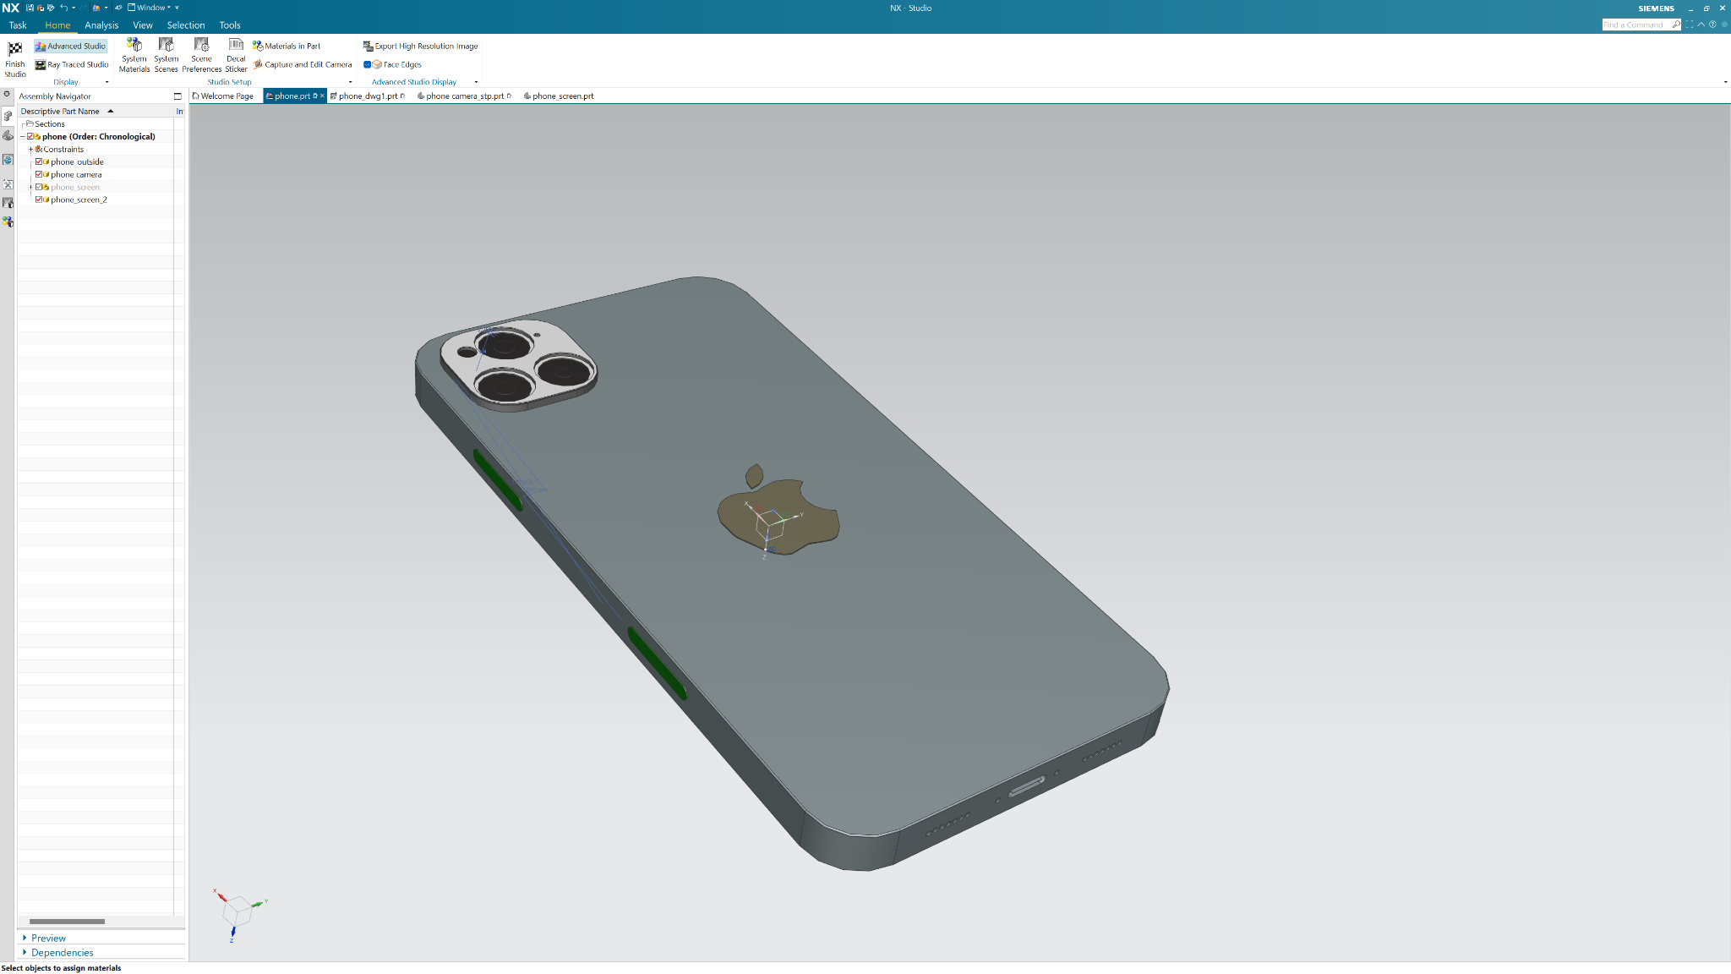
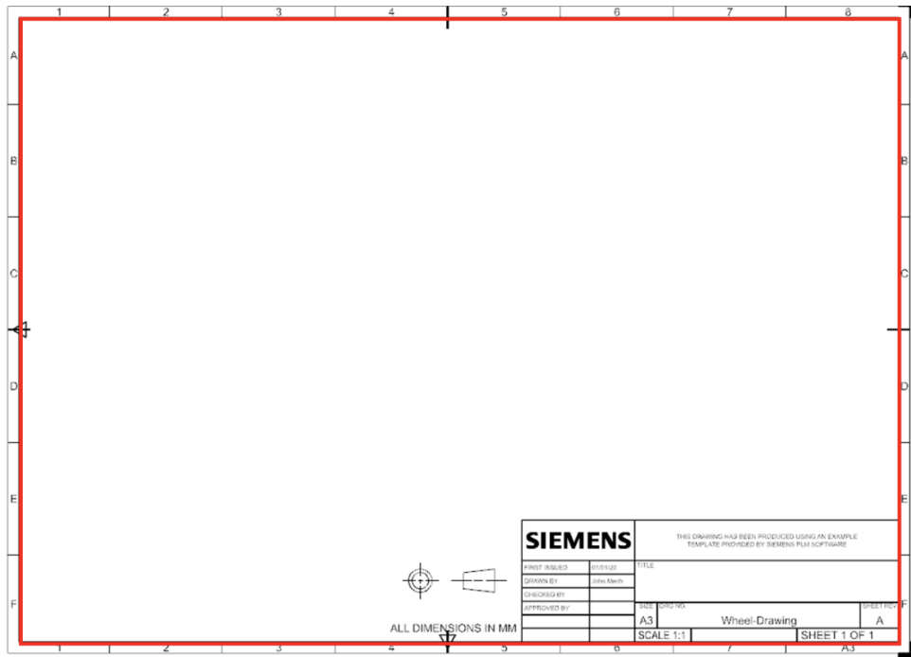
Introductory Project
01
02
03

Slide 12
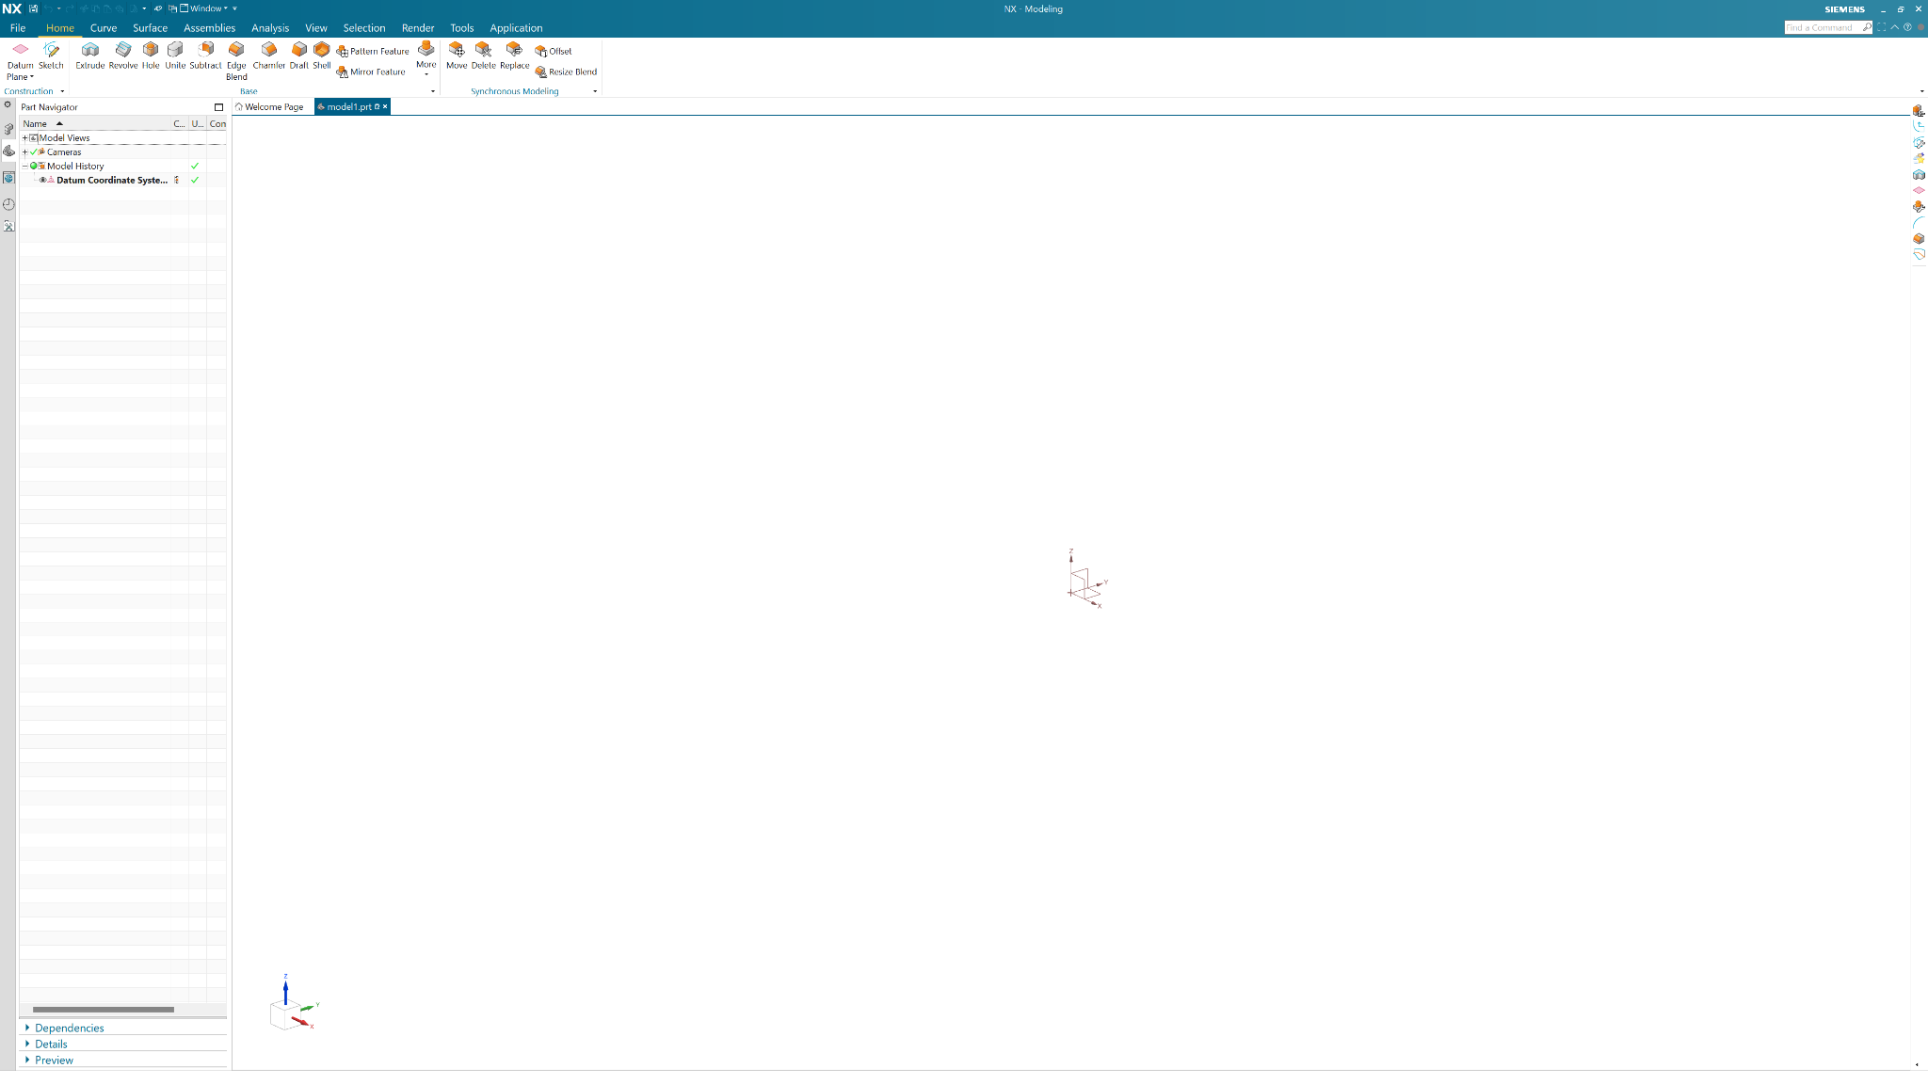
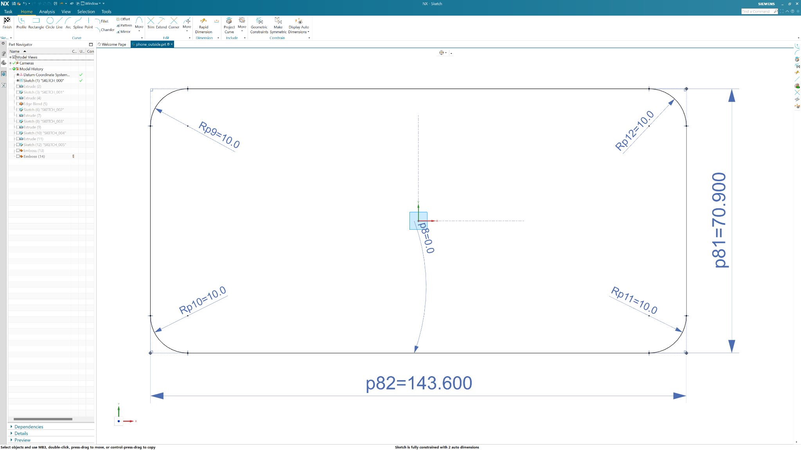
Creating Sketches
Starting sketches
Basic Shapes and Fillets
Dimensions
Notes:
6:15 - 6:25

Slide 13
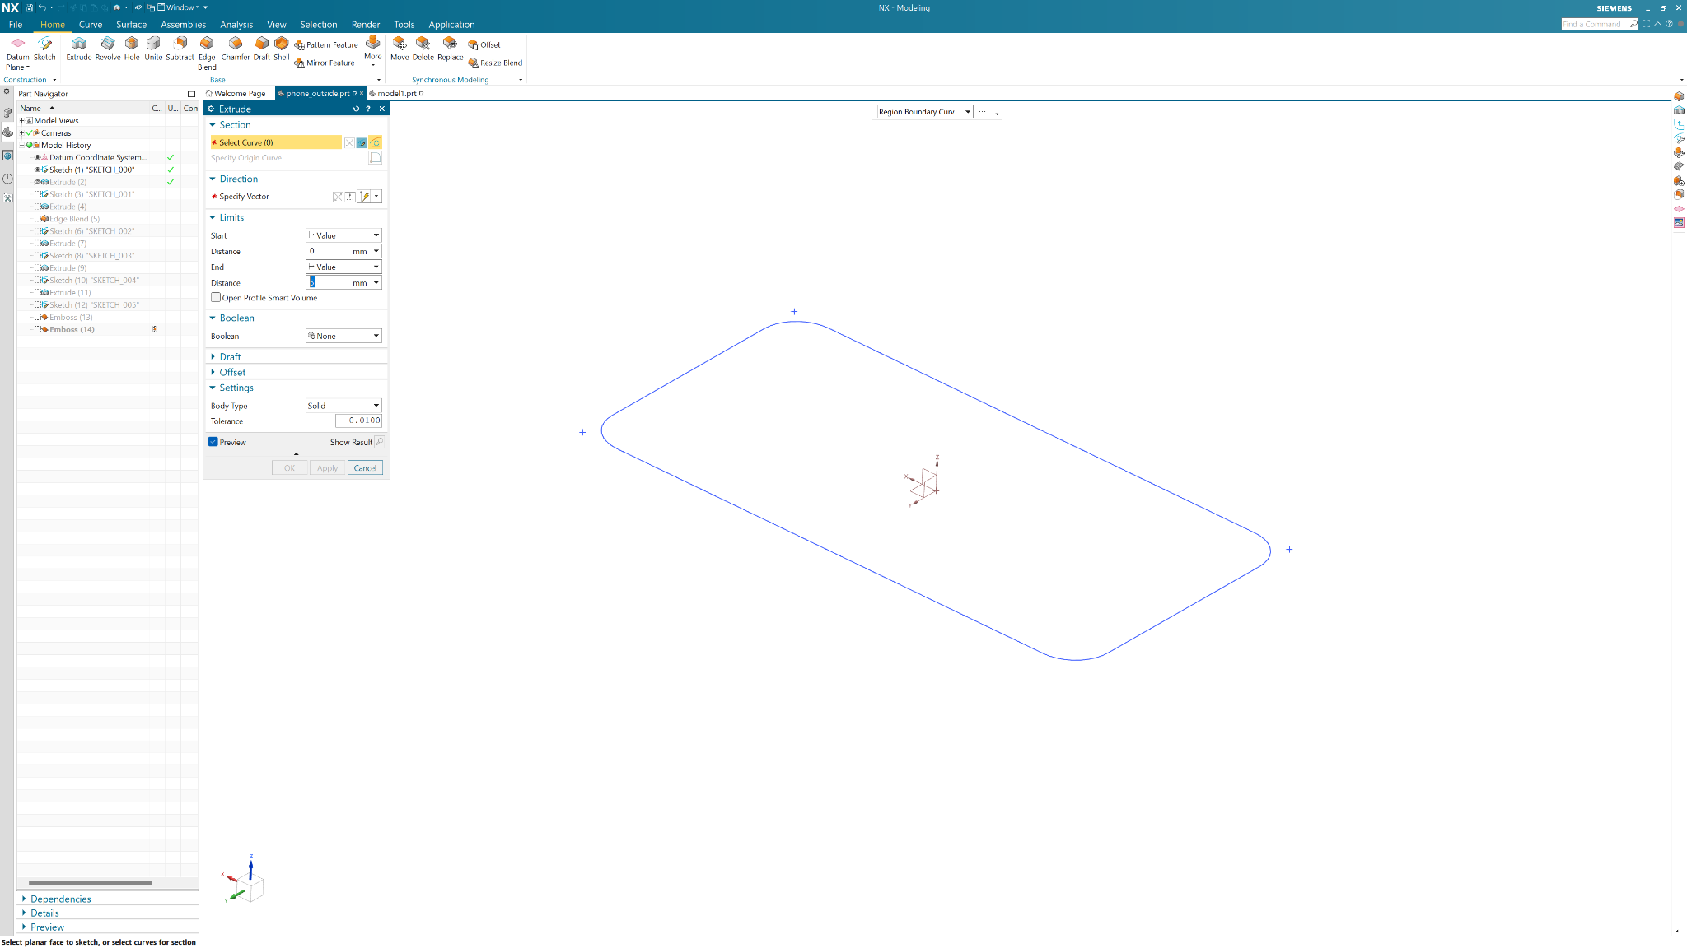
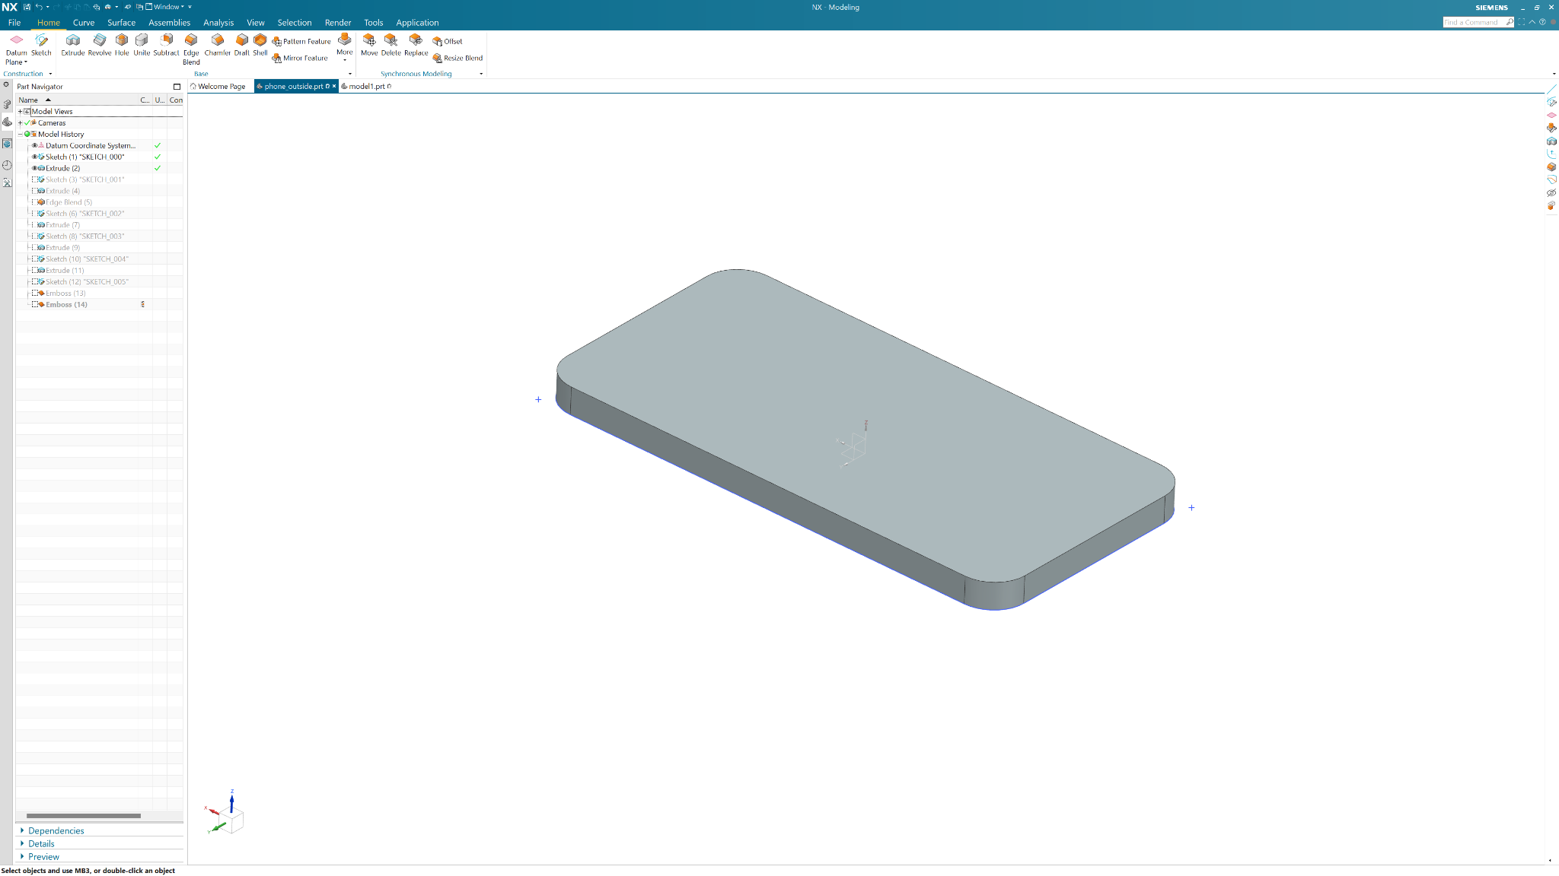
Making it 3D
Extrusions
7.7mm extrusion
Notes:
6:25 - 6:30

Slide 14
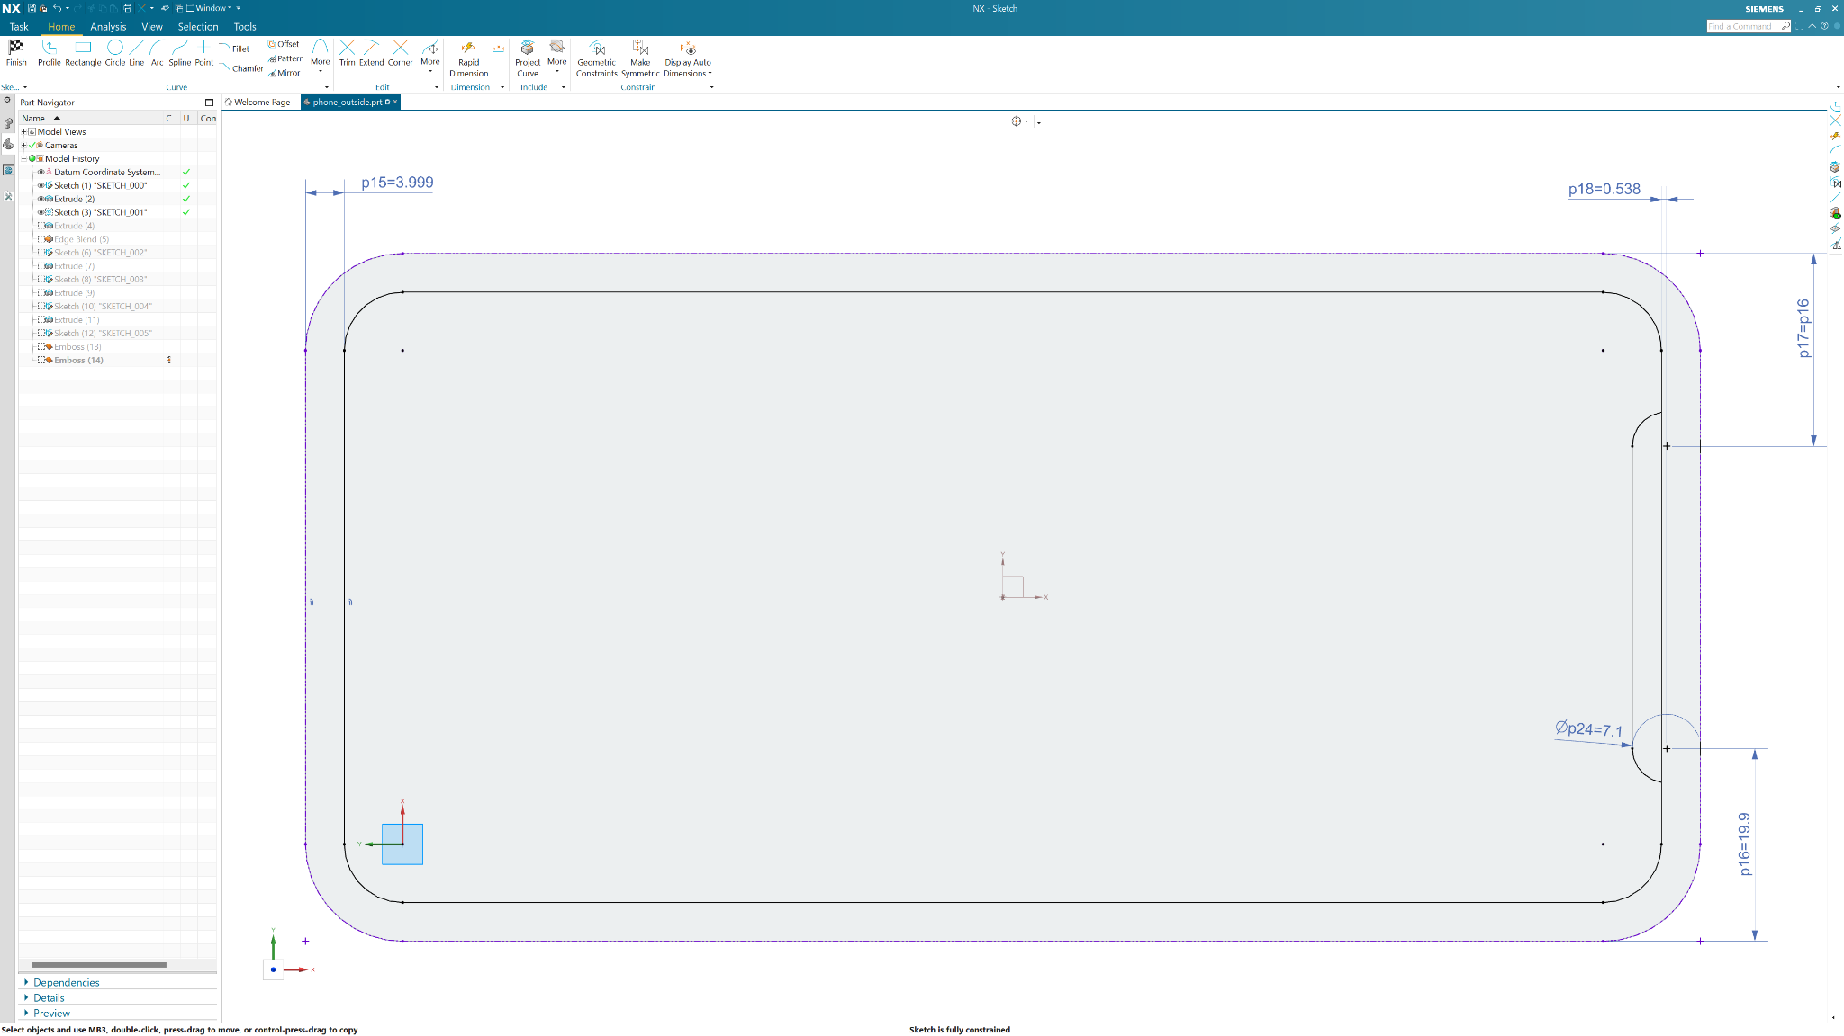
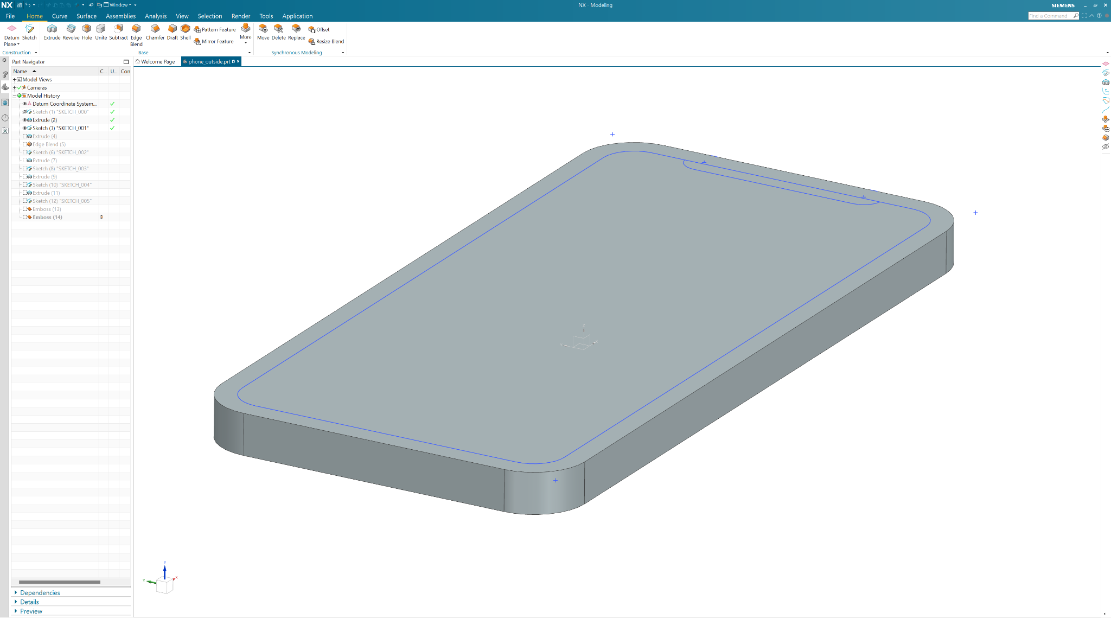
Sketches Pt. 2
Projecting Geometry
Offsets
Constraints
Construction Lines
Trim Feature
Notes:
6:30 - 6:50

Slide 15

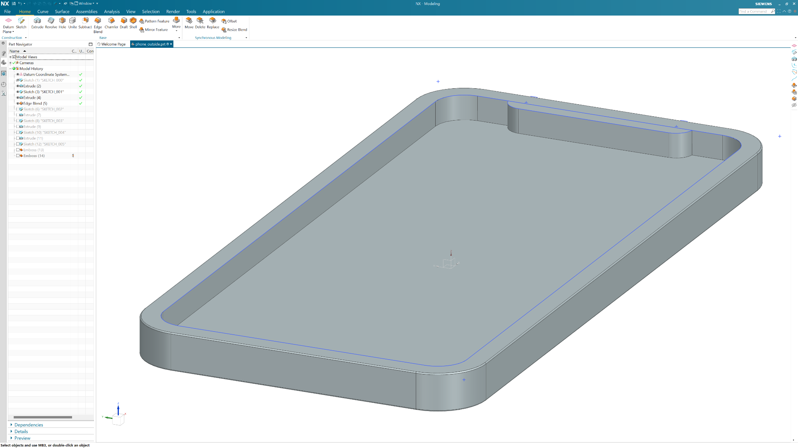
3D Features Pt. 2
Extrusions (again)
Fillets (Edge Blends)
5mm extrusion
0.25mm edge blend

Slide 16
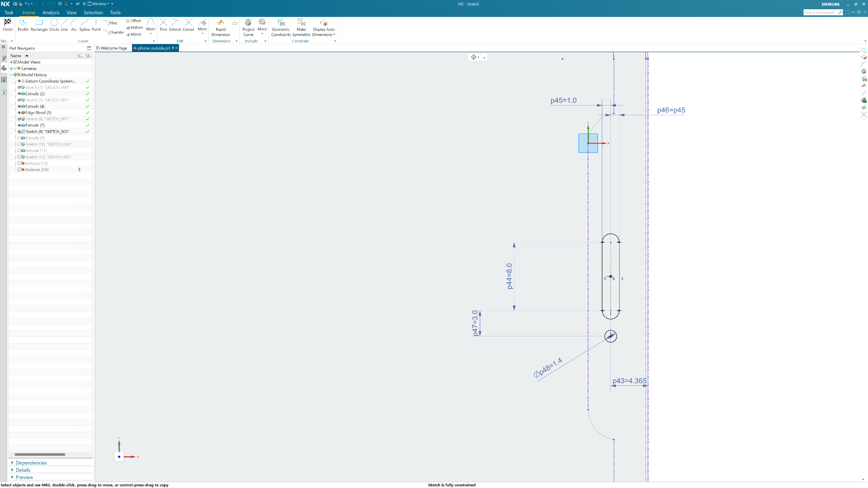
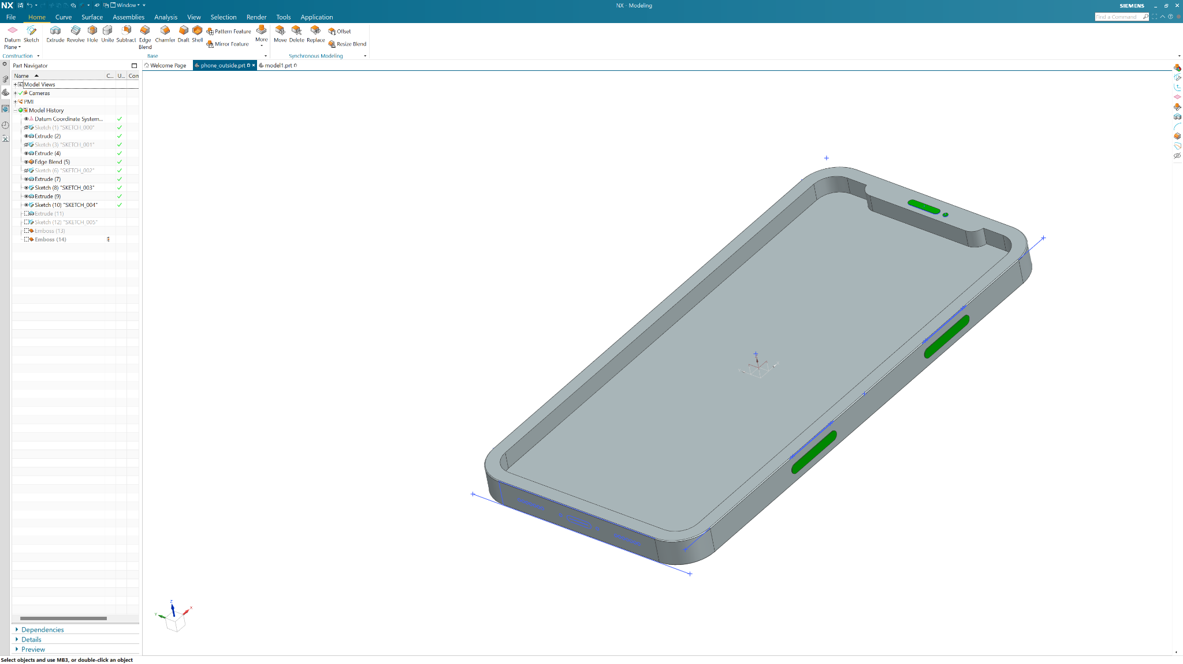
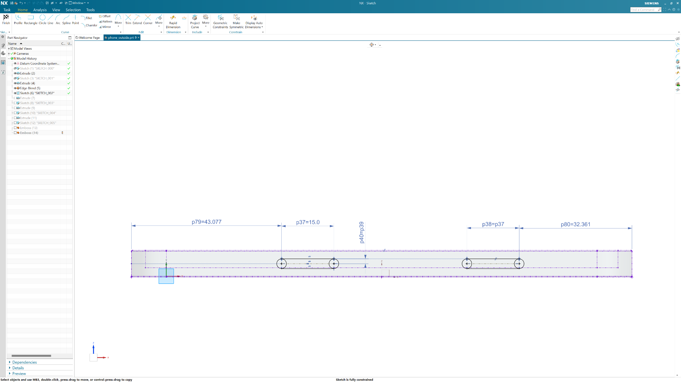
Details
0.2mm extrusion
Notes:
[Optional ~ 20mins

Slide 17
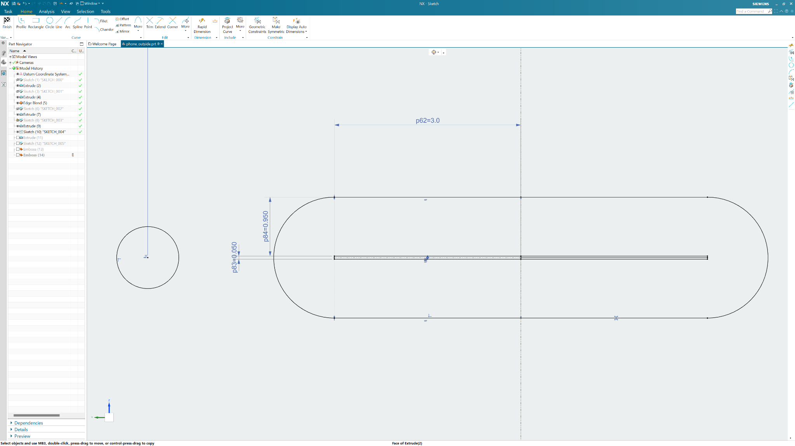
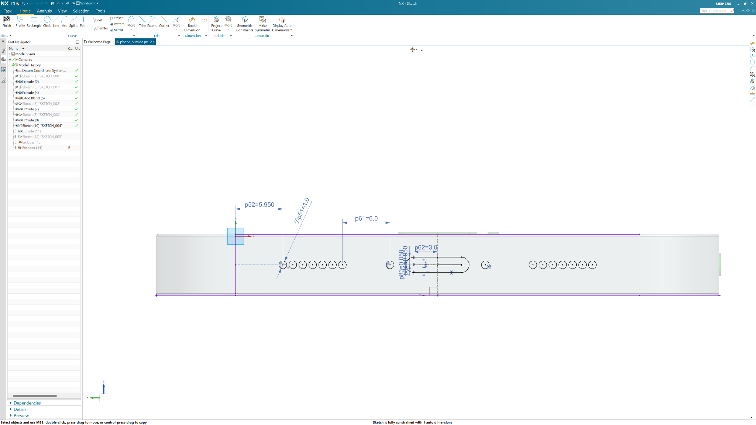
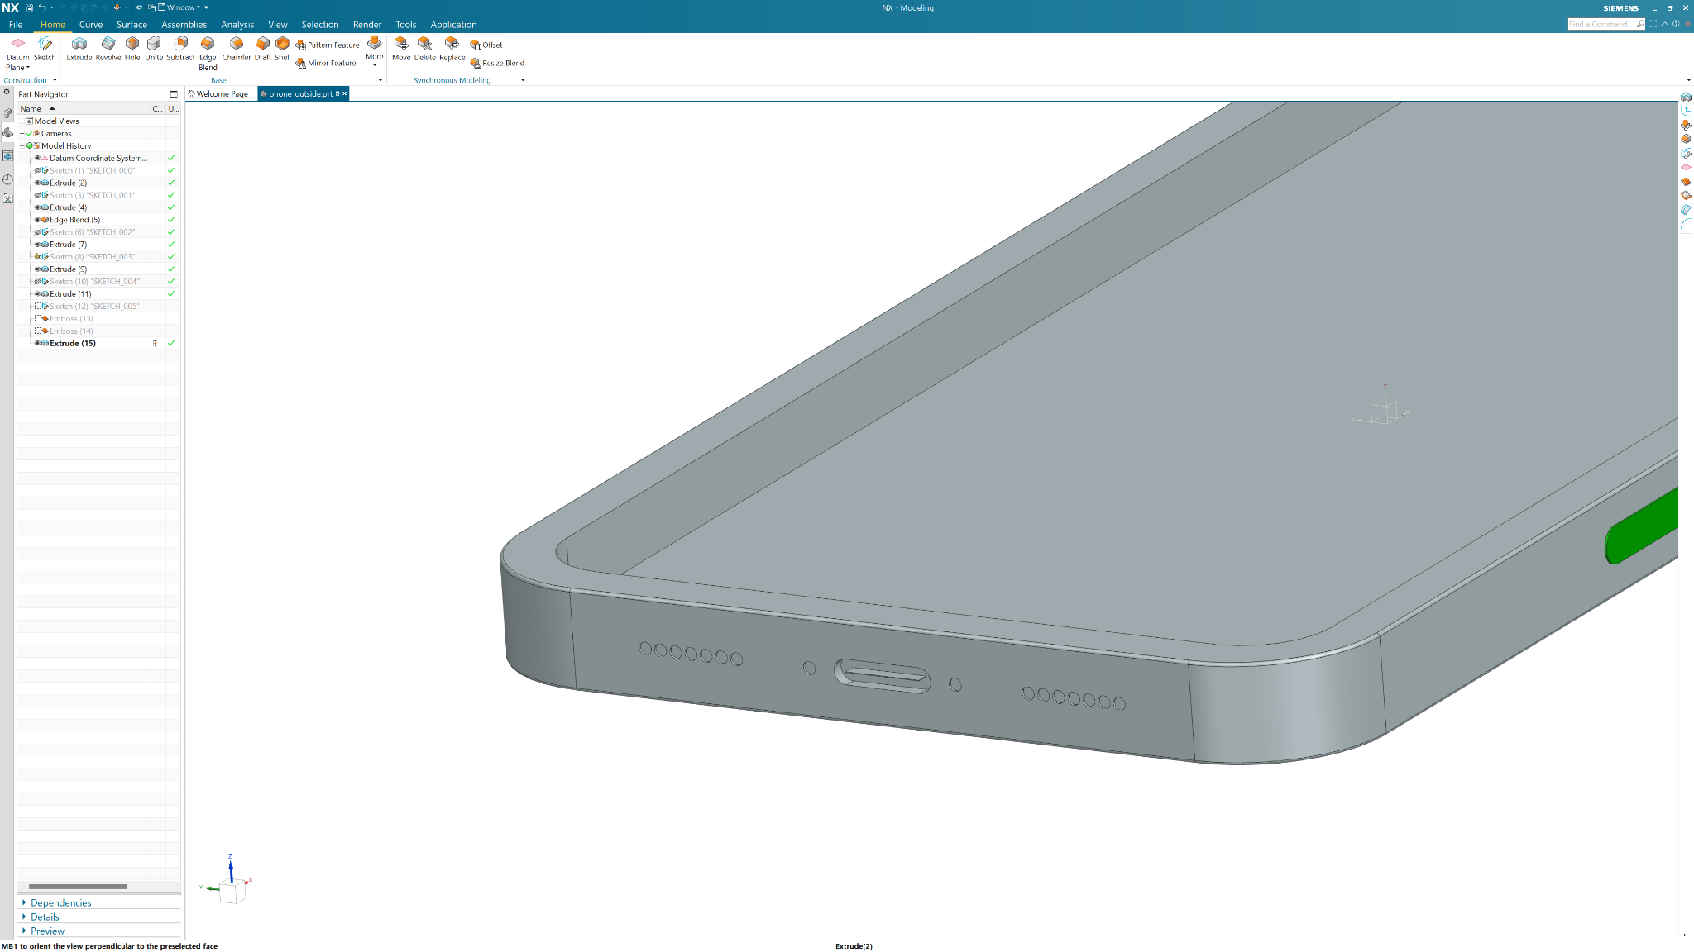
More Details
Patterns and Mirroring
0.2mm/1mm extrusion
Notes:
[Optional - 15mins}

Slide 18
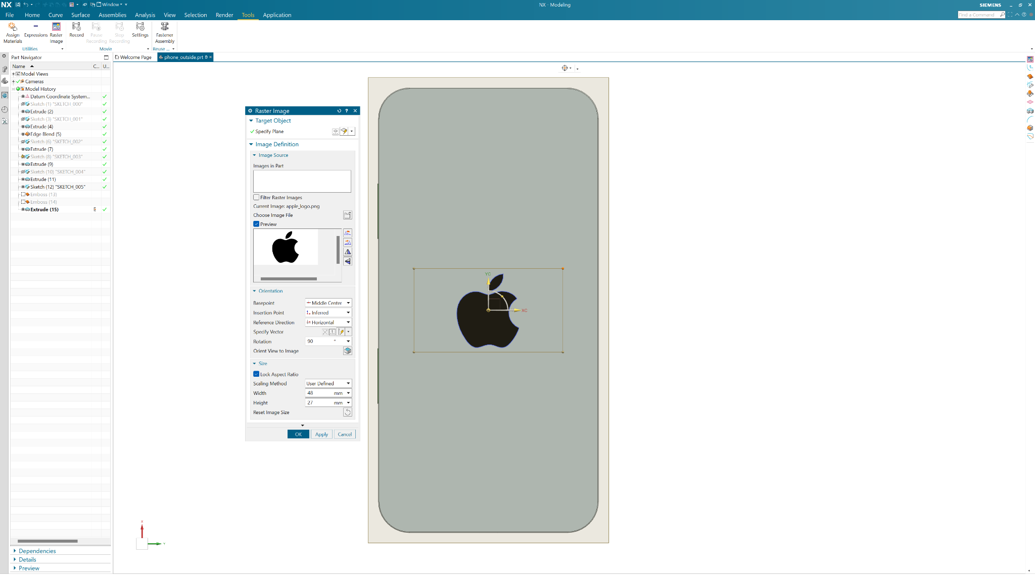
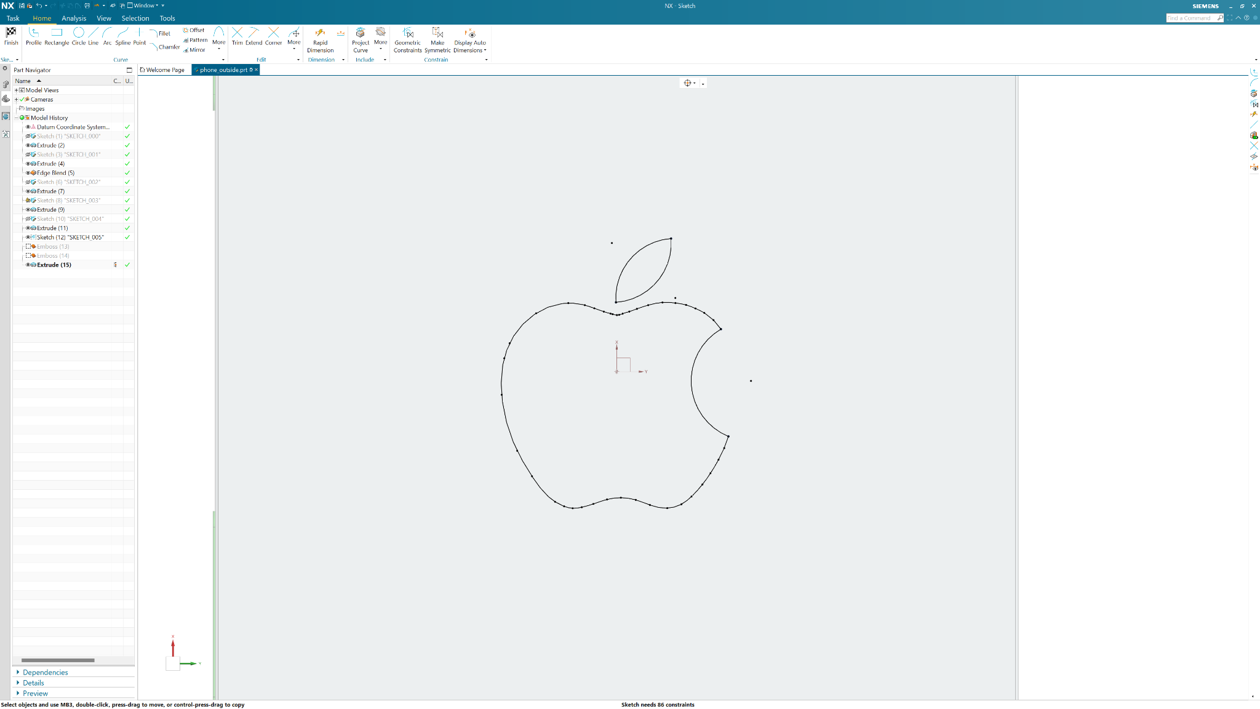
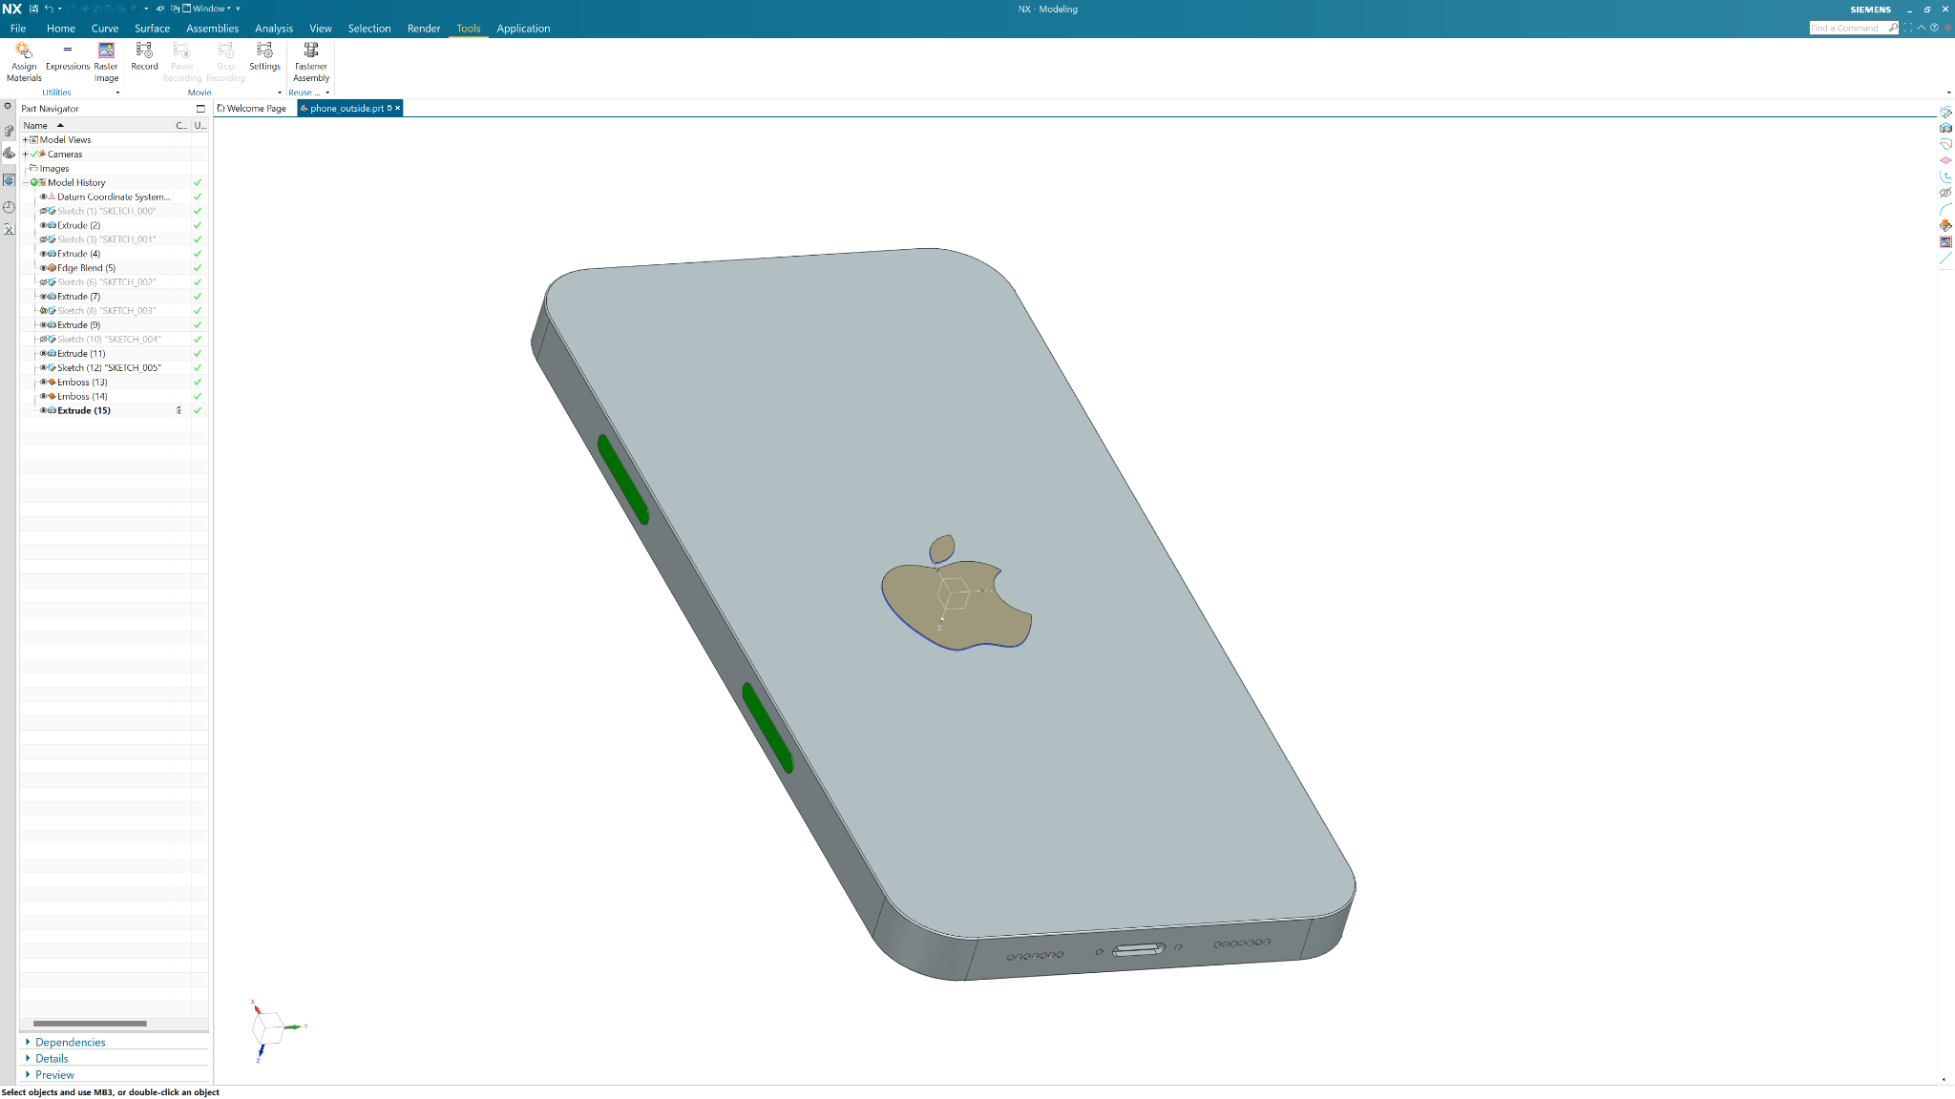
More Details
Embossing
Using images
Complex shapes
Notes:
[Optional - 10mins]

Slide 19
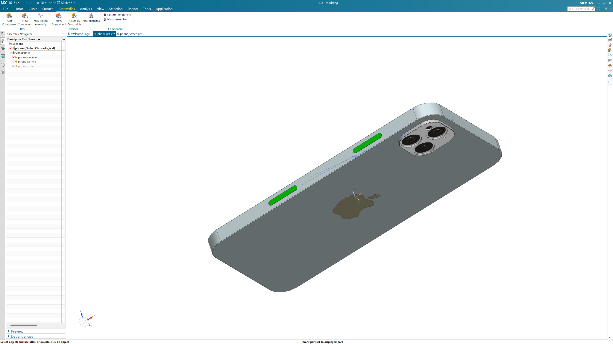
Assemblies
Importing Parts
Importing Downloaded Parts
Constraining
Notes:
6:50 - 7:05

Slide 20
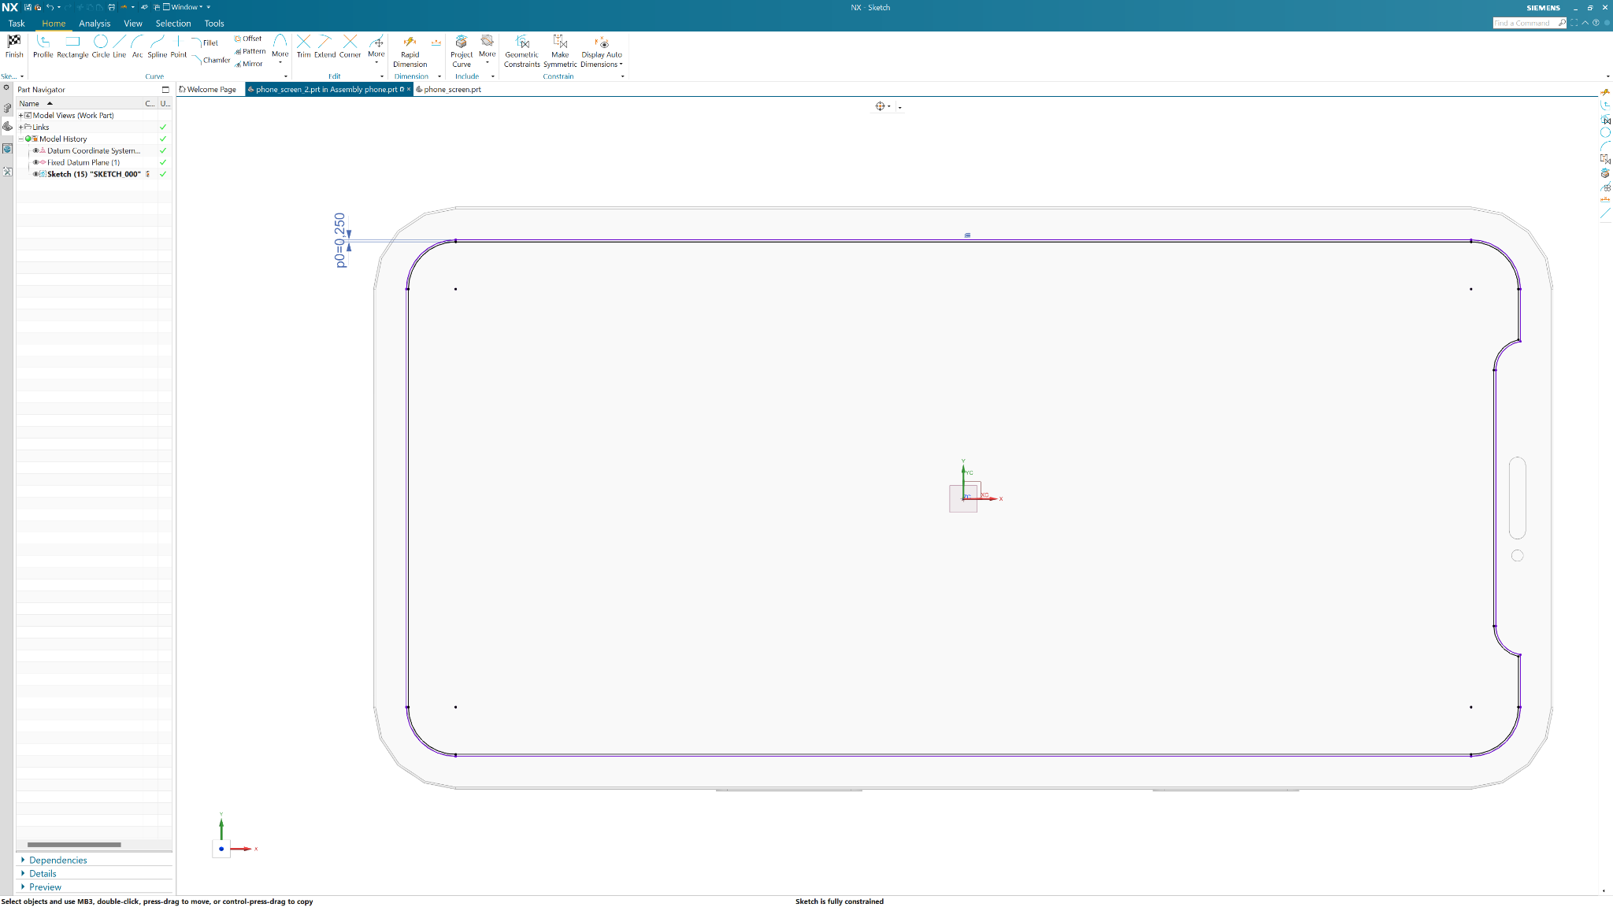
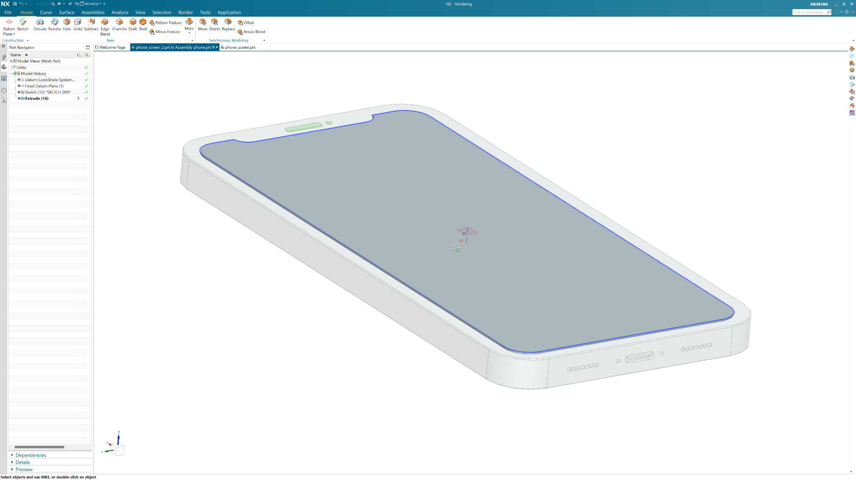
In-Place Parts
Creating Parts in Assemblies
0.5mm extrusion
Notes:
7:05 - 7:10

Slide 21
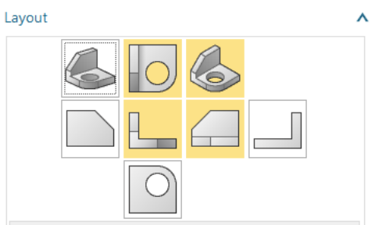
Drawings
Creating Drawings
Placing parts
Notes:
7:10 - 7:30
(1) Decide which views of the object are necessary (2) Decide the scale ratio for the drawing (3) Select the drawing sheet size (4) Lay out the drawing by – a. Laying out the views on the sheet; b. Laying out outlines and centre-lines; and c. Cleaning away unnecessary outlines. (5) Line-in the drawing by lining in: a. Centre-lines; b. Curves and radii; and c. Remaining outlines. (6) Finish off the drawing by – a. Inserting dimensions and notes; b. Filling in titles block and drawing border-lines and trim lines if not already provided.

Slide 22
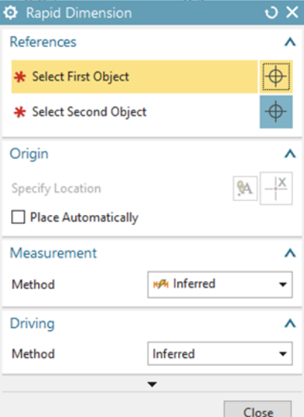
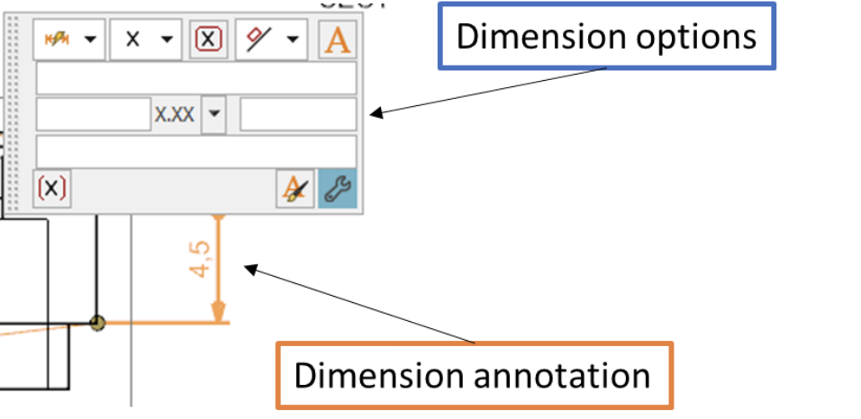
Details
Dimensions
Notes:
7:10 - 7:30

Slide 23
MARCH 2023
Q & A
UQ MARS x MESS
Notes:
Ideal start at 6:05pm

Slide 24
1
2
Write your first topic
or idea
Write your second topic or idea

Slide 25
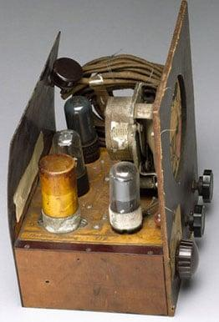
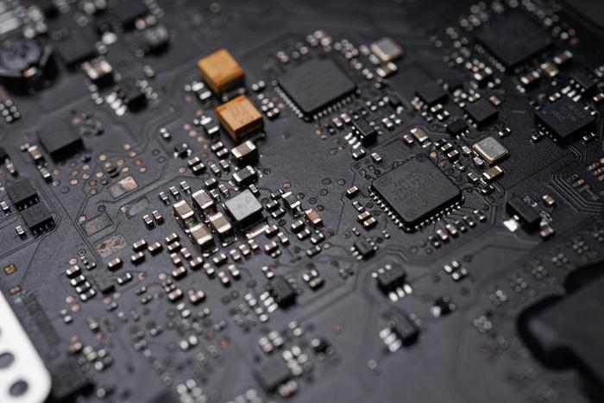
Printed Circuit Board
complex connection, manufacturing hurdles, debugging was difficult
A board which connects electrical components in a circuit by using conductive tracks and pads as opposed to wires.
provide electrical interconnections between components, a compact package that can be integrated into an end product.

Slide 26
Starting a New PCB Board Design
1
Front-end engineering
2
Schematic capture
3
Material selection and PCB stack-up design
4
Component placement
5
Routing
6
Design review and verification
7
Preparing for Manufacturing

Slide 27
Add a heading
Present with ease and wow any audience with Canva Presentations. Choose from over a thousand professionally-made templates to fit any objective or topic. Make it your own by customizing it with text and photos.
Apply page animations and transitions to your Canva Presentation to emphasize ideas and make them even more memorable.
Link Name
Link Name

Slide 28
Write a heading
with button links
Link Name
Link Name

Slide 29
Add a heading
Write your topic or idea
Write your topic or idea
Write your topic or idea
Write your topic or idea

Slide 30
Add a heading
Present with ease and wow any audience with Canva Presentations. Choose from over a thousand professionally-made templates to fit any objective or topic.
Make it your own by customizing it with text and photos.
Apply page animations and transitions to your Canva Presentation to emphasize ideas and make them even more memorable.

